Slide 1


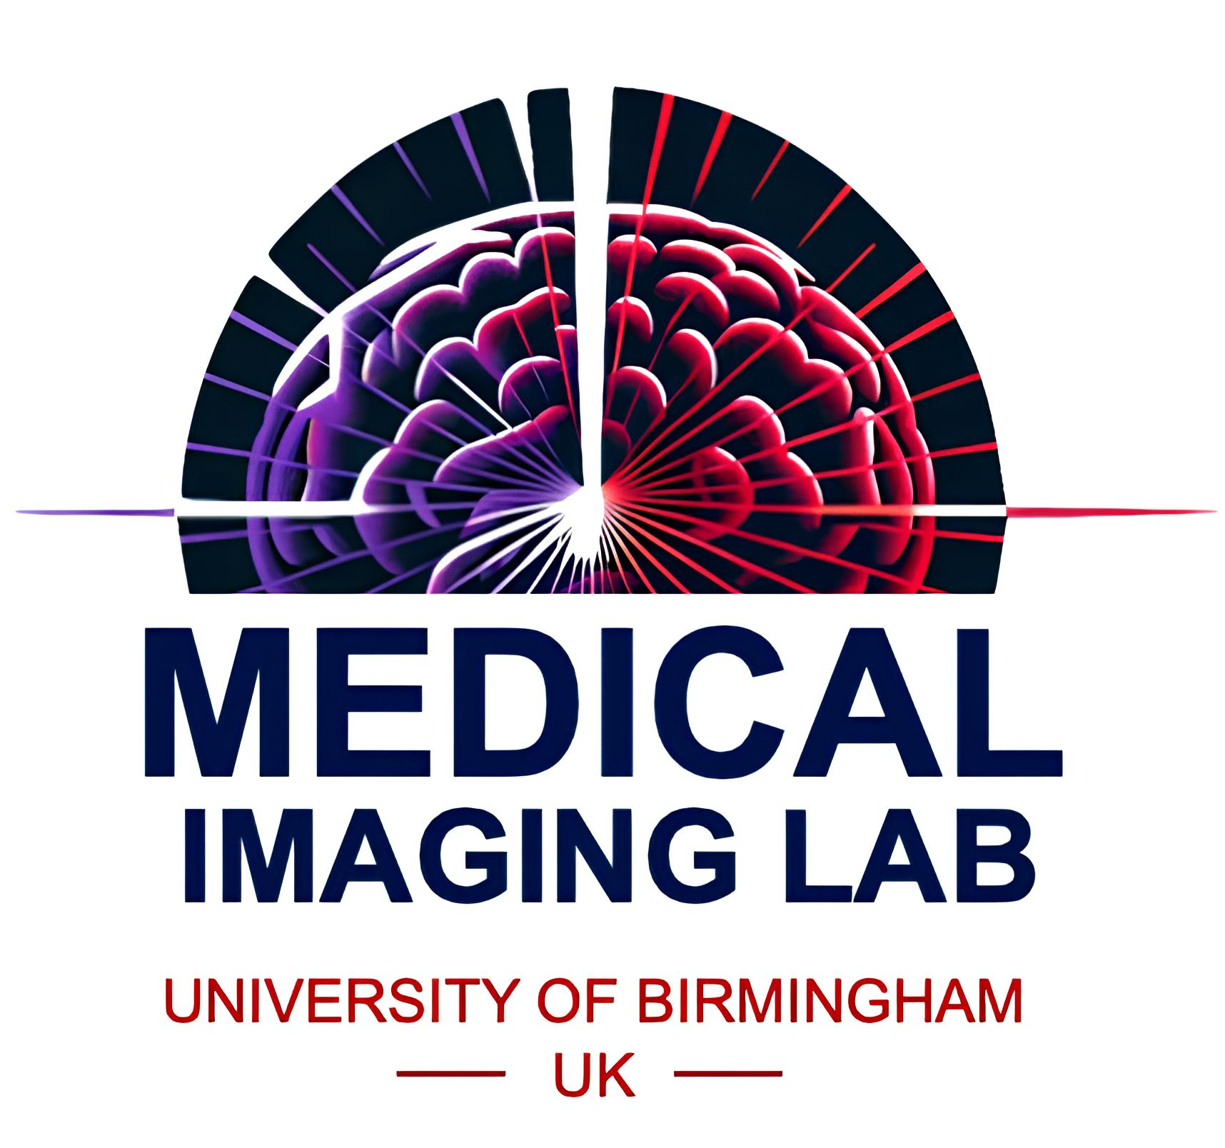
NIRFAST
A Brief history
Jiaming Cao¹ and Hamid Dehghani²
1. Centre for Cognitive and Brain Sciences,
Institute of Artificial Intelligence and Brain Sciences
University of Macau
2. School of Computer Science,
Center of Human Brain Health,
University of Birmingham, UK

Slide 2
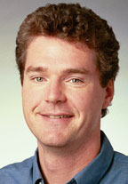
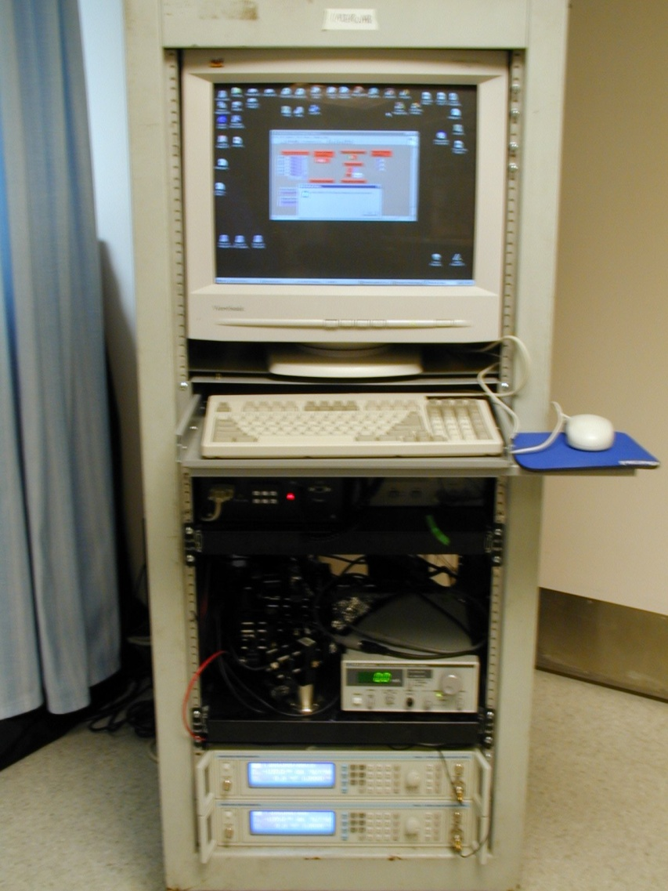
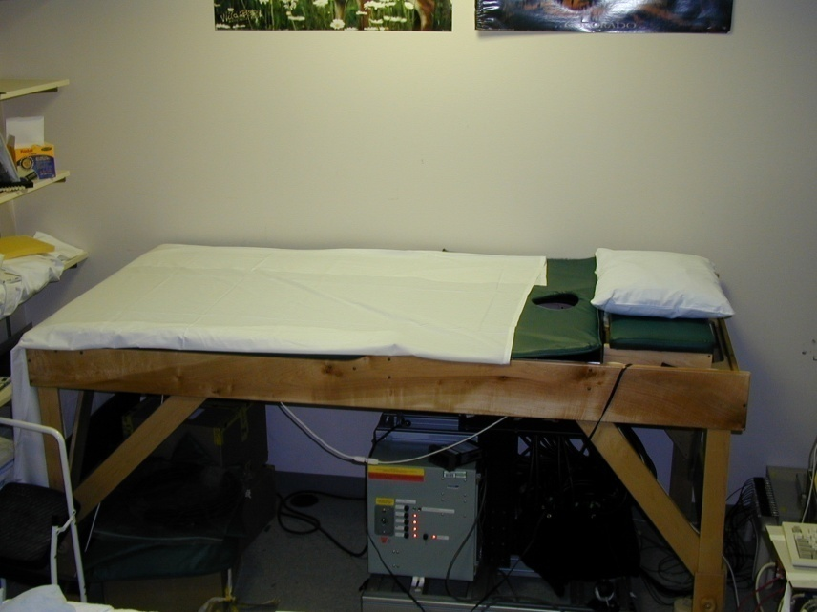
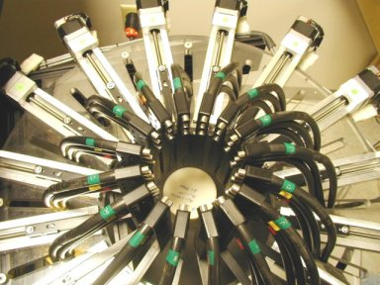
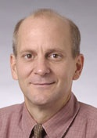
The Beginning: August 2001
Develop 3D finite element model and imaging algorithms for Breast Imaging system
Do it in Fortran!

Slide 3
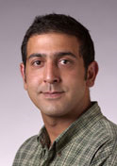
The Beginning: August 2001
Can I develop this under MATLAB?
Reasons:
  Platform independent tool
  Well developed and optimized tools
  Easy to write
    Easy to read
  Allowed multi-user development
The real reason:
  I never had used Fortran!

Slide 4
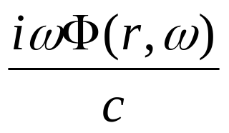
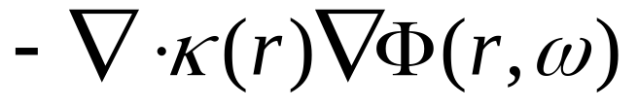
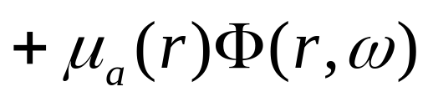
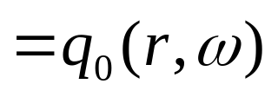

Light Transport Model
Light transport in tissue is turbid (scatter-dominated),
modelled by diffusion equation:
Frequency
variation
diffusion
absorption
source
Field Φ: photon density
μ_{a} = Absorption Coefficient
κ = 1/3(μ_{a}+ μ_{s}`)
Boundary condition:
Dehghani et al, Applied Optics 2003

Slide 5
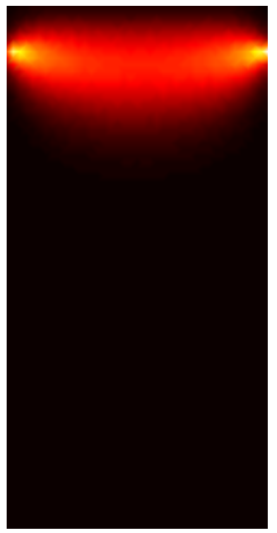
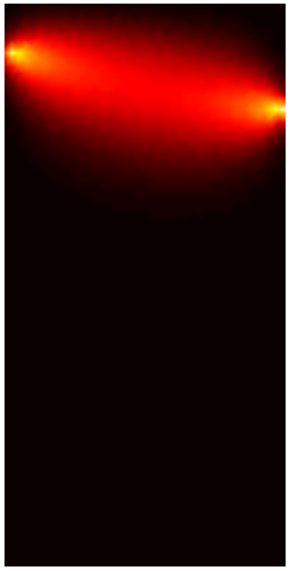
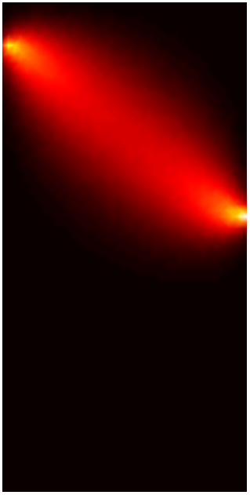
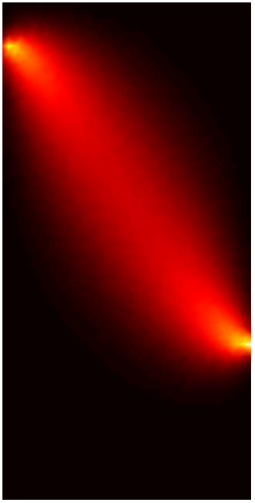
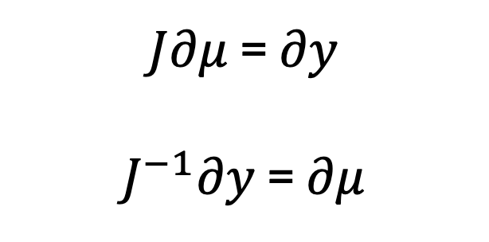
Image Reconstruction
The Jacobian (Weigh Matrix, A Matrix, Sensitivity matrix):
Relates a small change in optical properties to a change in measured data
Calculated using the adjoint method
$J∂μ$ = $∂y$
$J^{−1}∂y$ = $∂μ$
More on this later!

Slide 6
Prior information in Near-Infrared Spectroscopy and Imaging process
Pogue et al, Phil. Trans. R. Soc. A (2011)

Slide 7
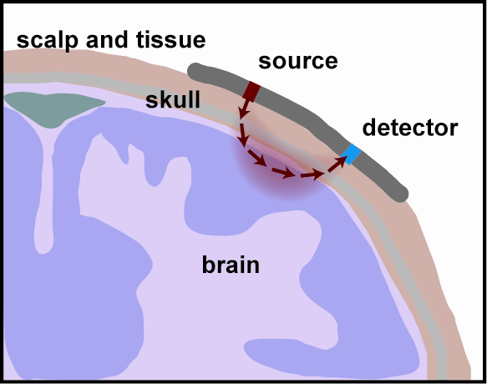
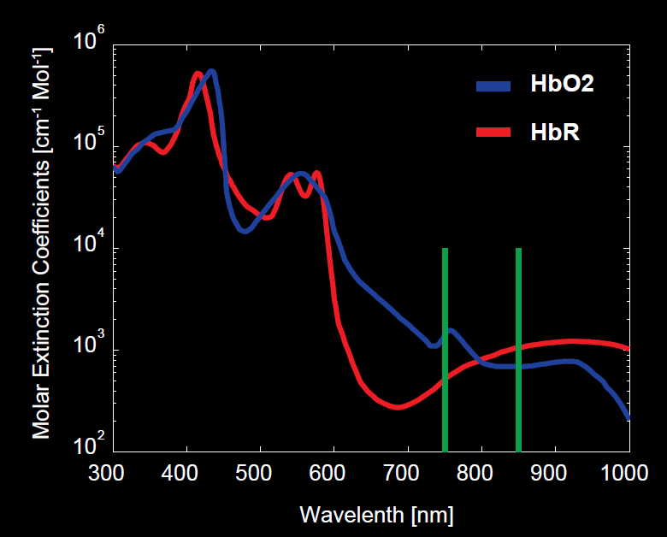
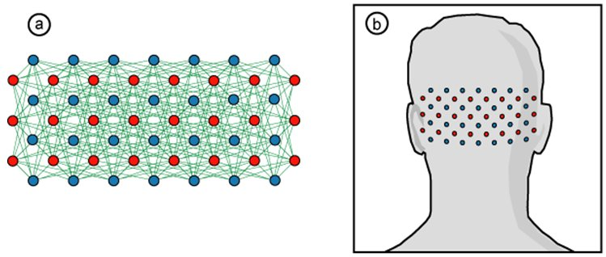
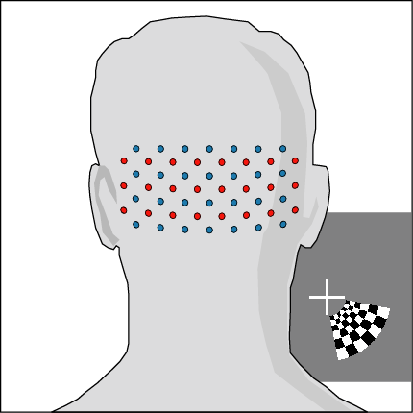
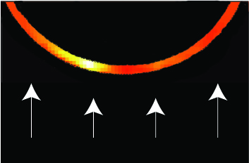
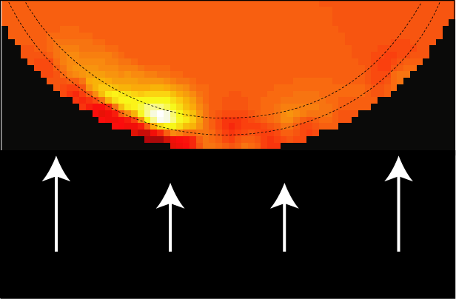
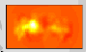
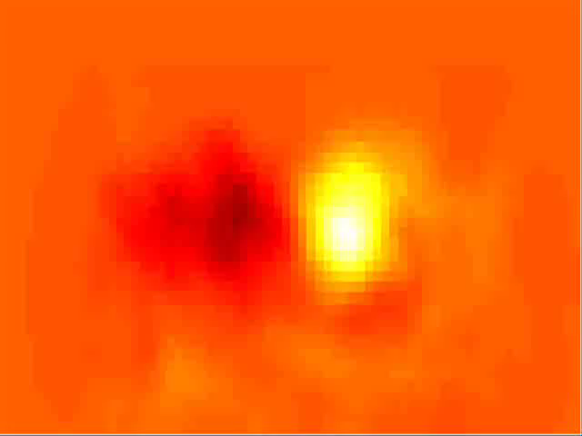
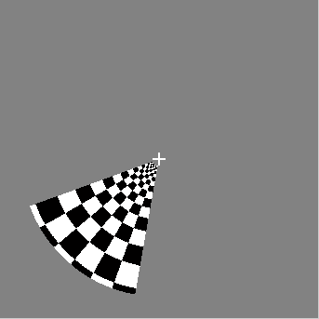
Optical functional brain imaging
Diffuse optical imaging (DOI) has many unique advantages:
  Portable equipment
  Wearable imaging cap
  Non-invasive
Coronal Projection
Axial Slice
Zeff et al. PNAS, 2007

Slide 8
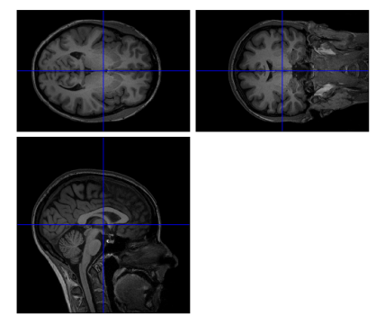
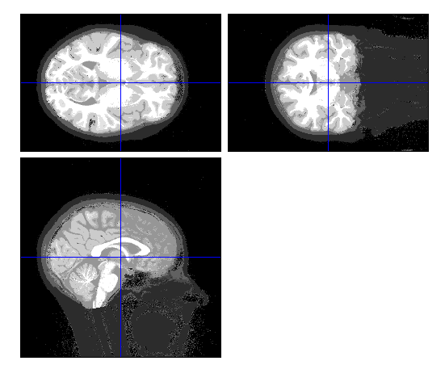
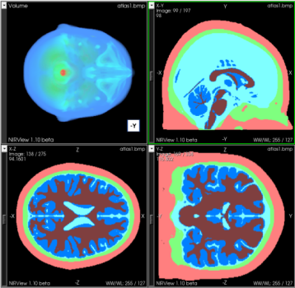
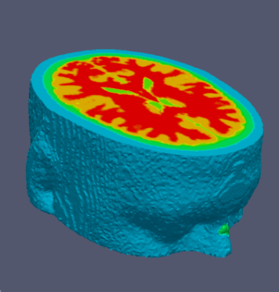
Model Creation and discretisation
MRI scans
SPM
Segmented
scans
NIRFAST-Slicer
Masks
NIRFAST
Volume Mesh
< 2 minutes
< 1 minute
< 3 minutes
In total ~5 Minutes
SPM: Statistical Parametric Mapping http://www.fil.ion.ucl.ac.uk/spm/
Meshing based on the computational geometry algorithms library (CGAL) implemented in NIRFAST: http://www.nirfast.org

Slide 9
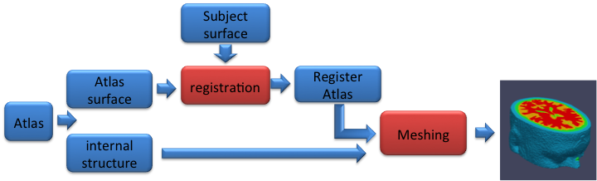
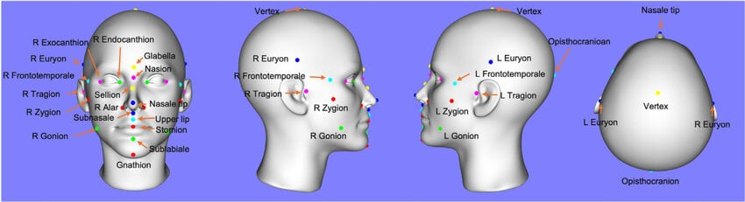
Atlas based models
Basevi et al, Optics Express, 2013

Slide 10
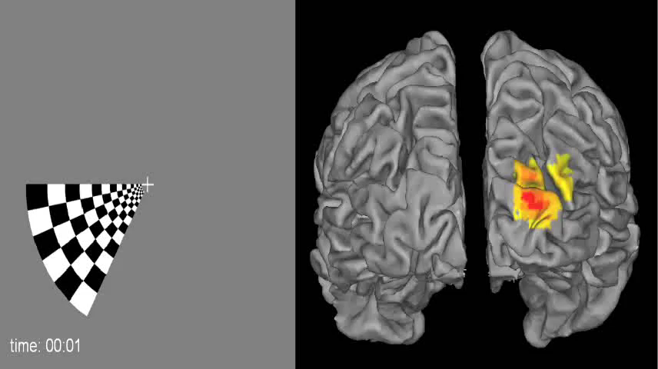
Atlas based models
Eggebrecht et al, NeuroImage 2012

Slide 11
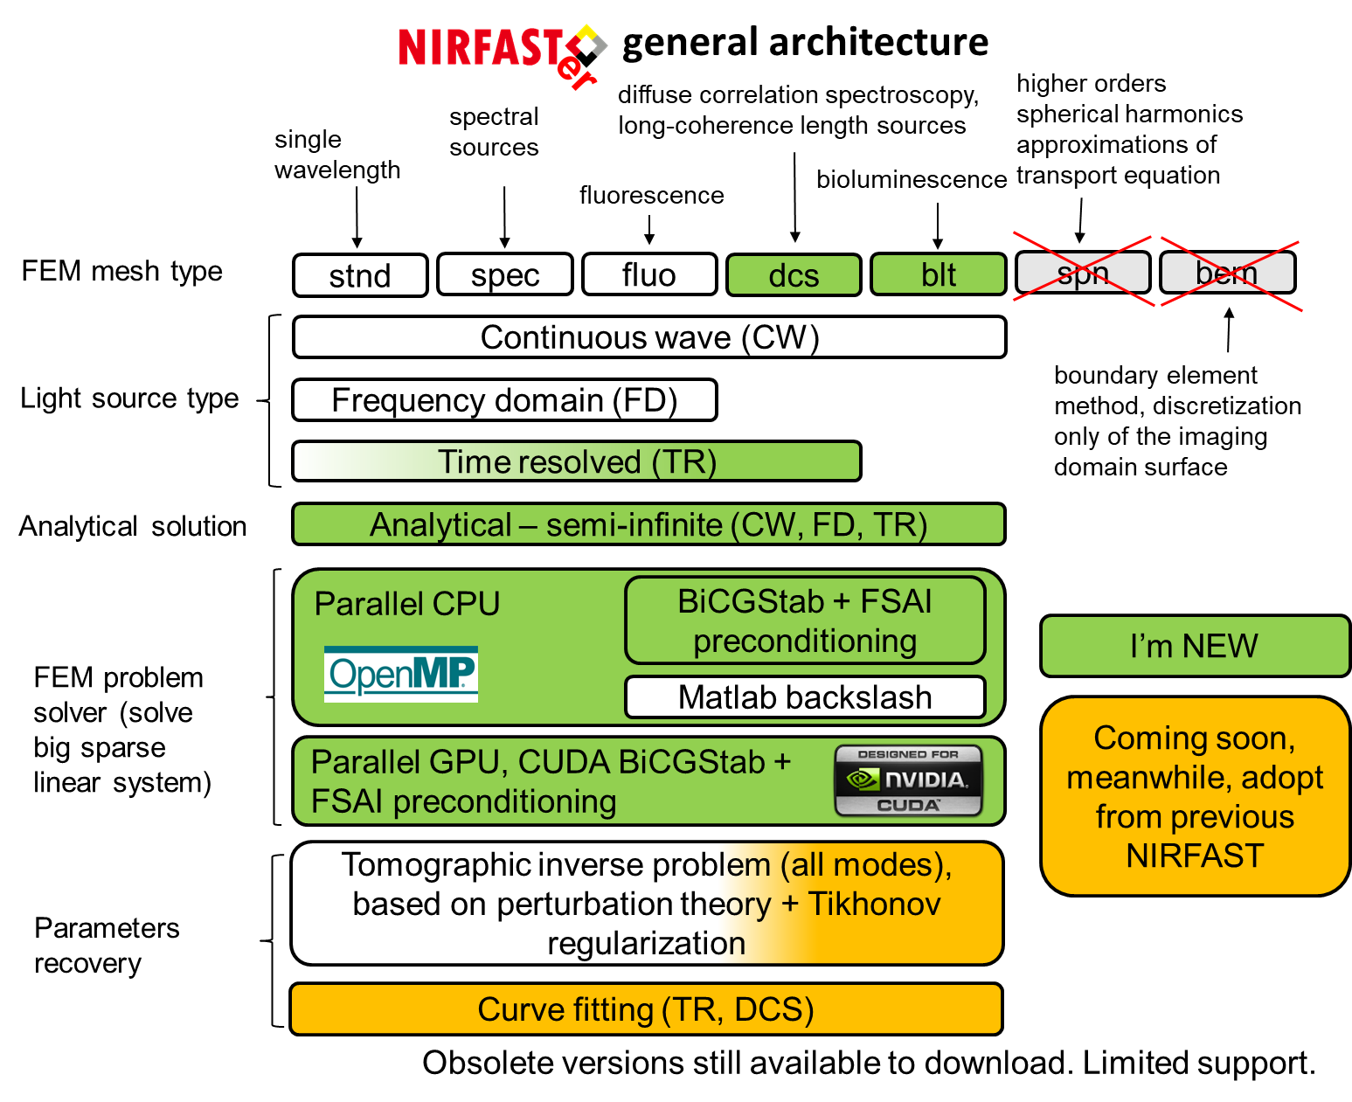
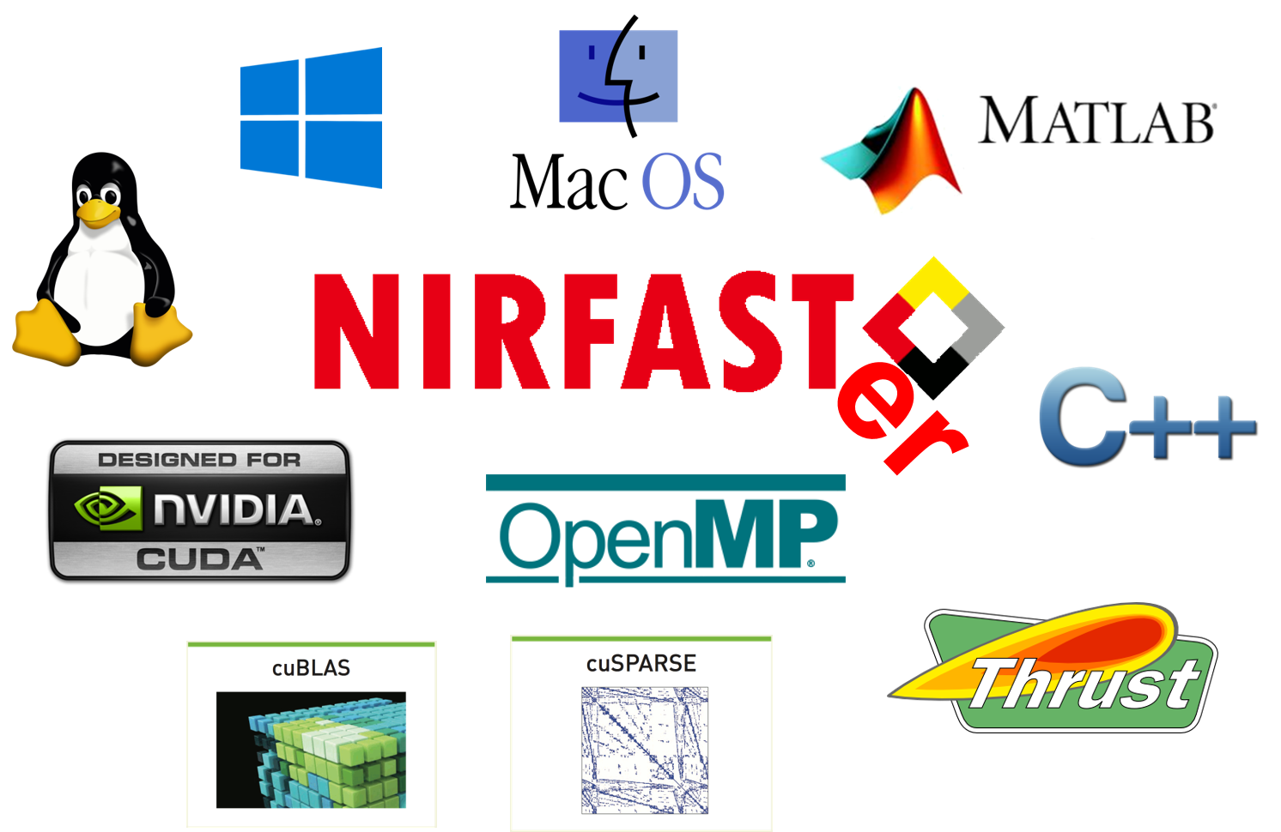
NIRFASTer and NIRFASTerFF

Slide 12
…

Slide 13
Questions?

